Slide 1

.NET Configuration In Depth
Chris Ayers

Slide 2




















































Titanium Sponsors
Speaker Dinner Sponsor
Platinum Sponsors
Gold Sponsors

Slide 3

Senior FastTrack Engineer Microsoft Twitter: @Chris_L_Ayers LinkedIn: Chris-L-ayers Blog: https://chrislayers.com/ GitHub: @Codebytes

Slide 4

Agenda
What is configuration?
How does .NET Framework handle configuration?
How does .NET (Core, 5,6) and ASP.NET handle configuration?
Configuration Providers
Configuration Binding
The Options Pattern
Questions

Slide 5

Configuration

Slide 6
What is Configuration?
Settings
Retry Times
Queue Length
Feature Flags
Secrets
Connection Strings
Per User
Percentage
App Registration

Slide 7
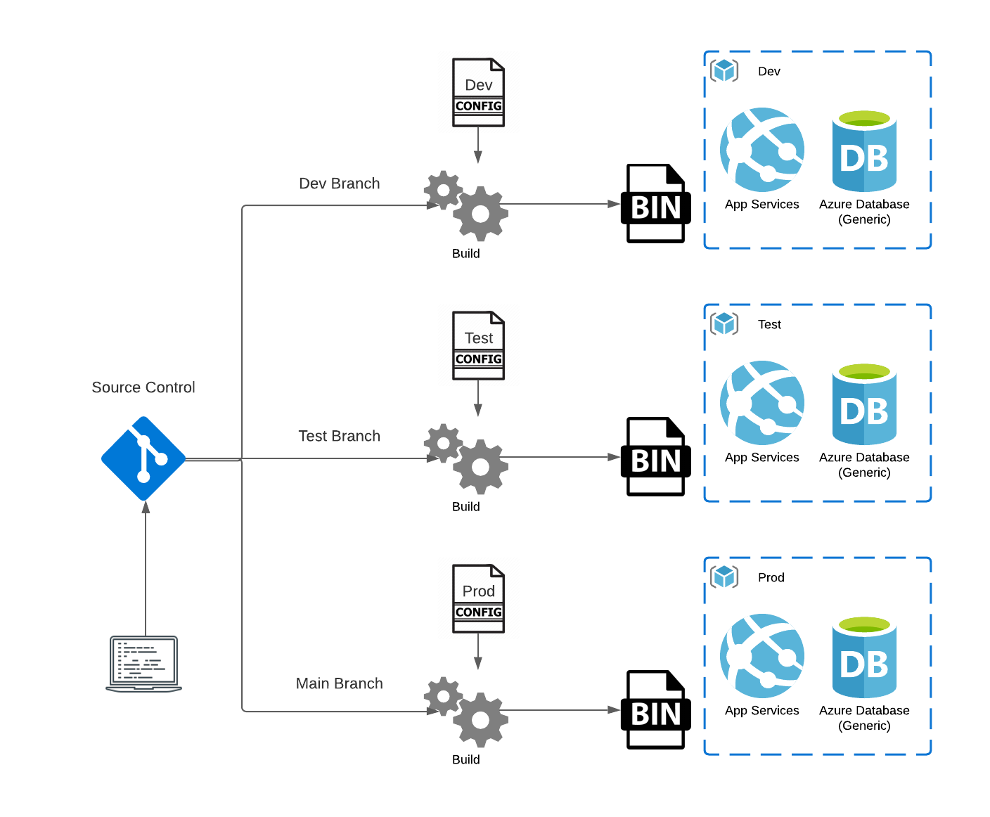
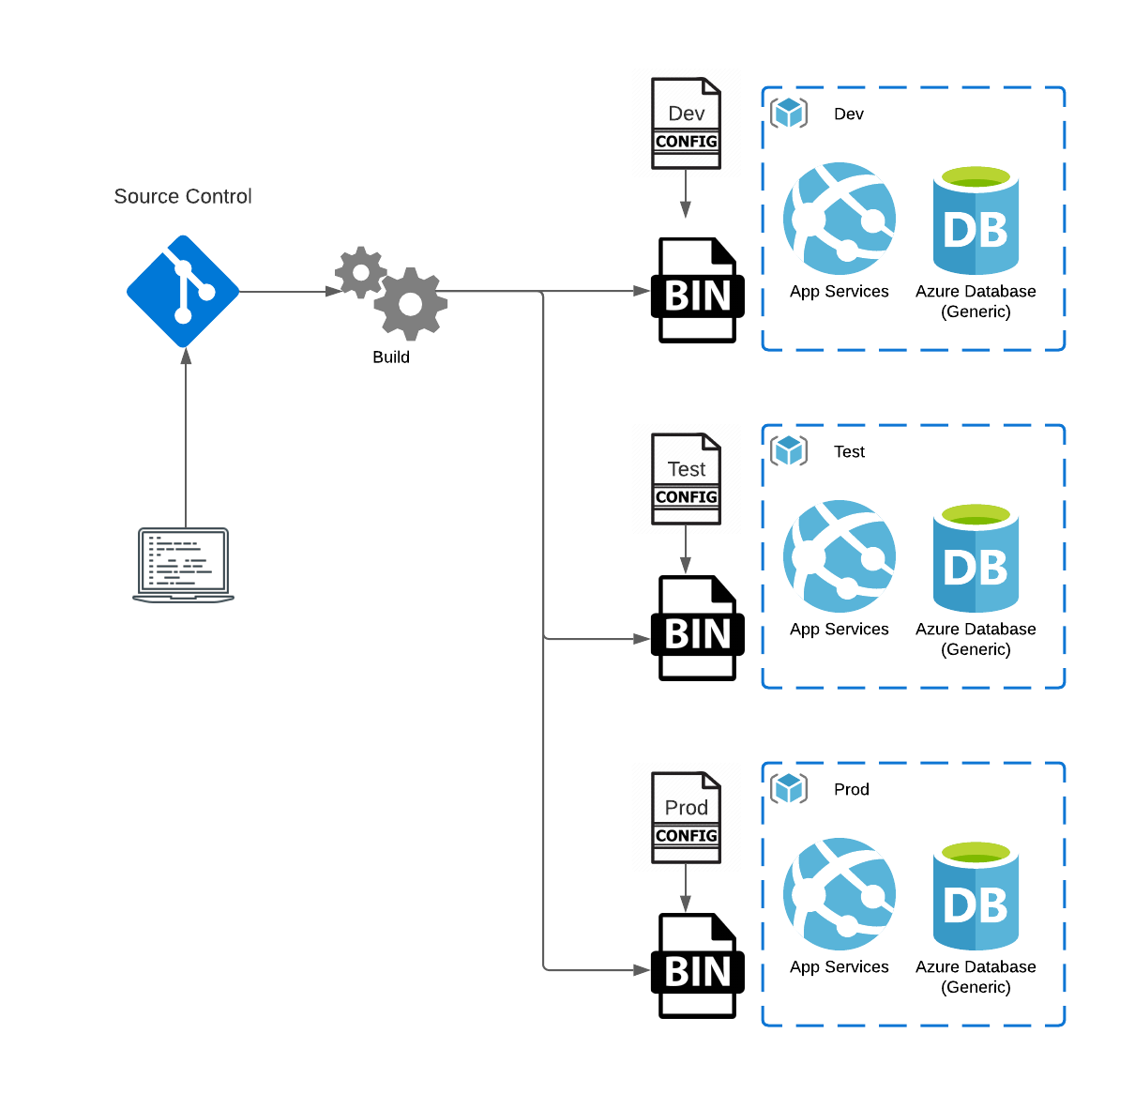
When is configuration applied?
Compile time
Run time

Slide 8

.NET Framework Configuration

Slide 9
Web.Config
Limited to Key-Value string pairs
Accessed through a static ConfigurationManager Class
Dependency Injection was not provided out of the box
Transformation through difficult syntax
Slow Cheetah
Hard to unit test
Easy to leak secrets

Slide 10
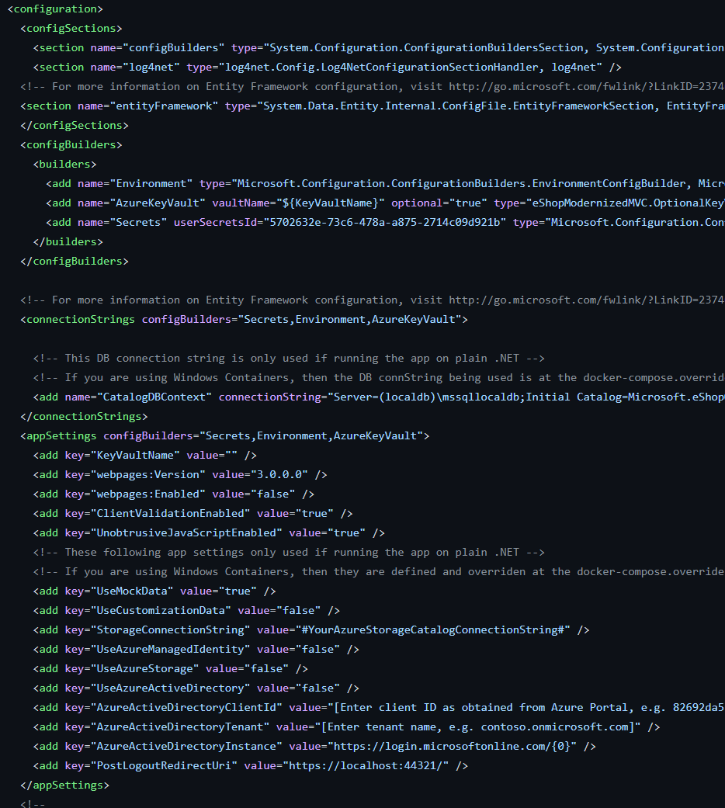
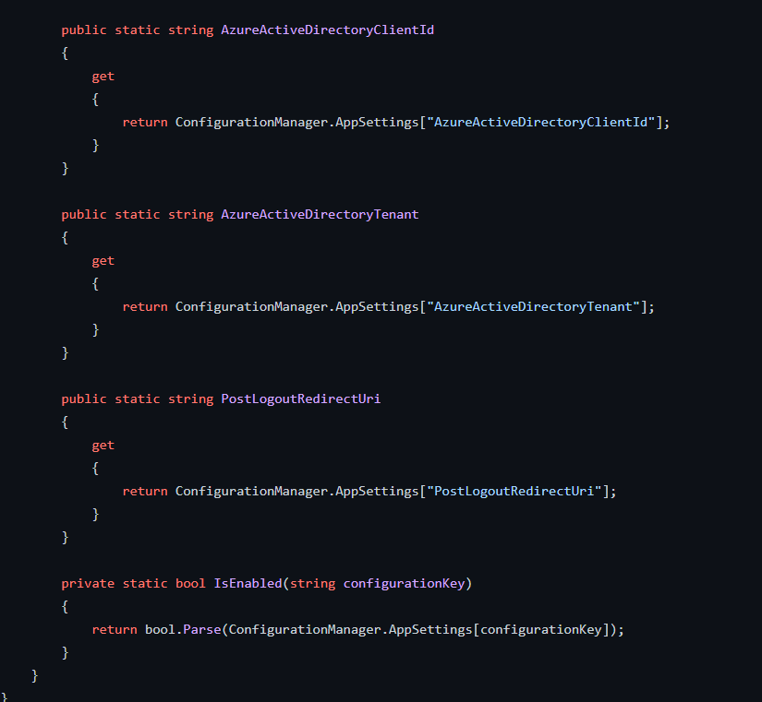
XML, Static Classes, and Parsing

Slide 11
.NET 6/ASP.NET Configuration

Slide 12
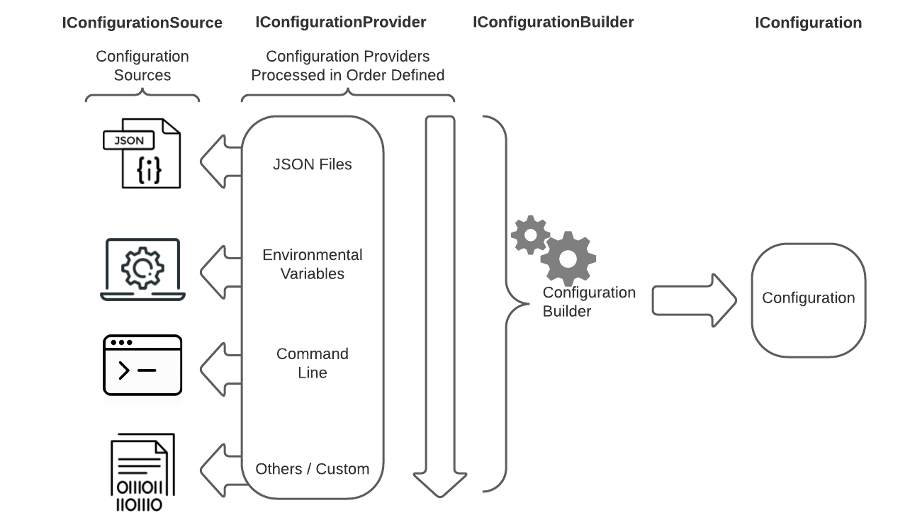
Configuration Providers

Slide 13
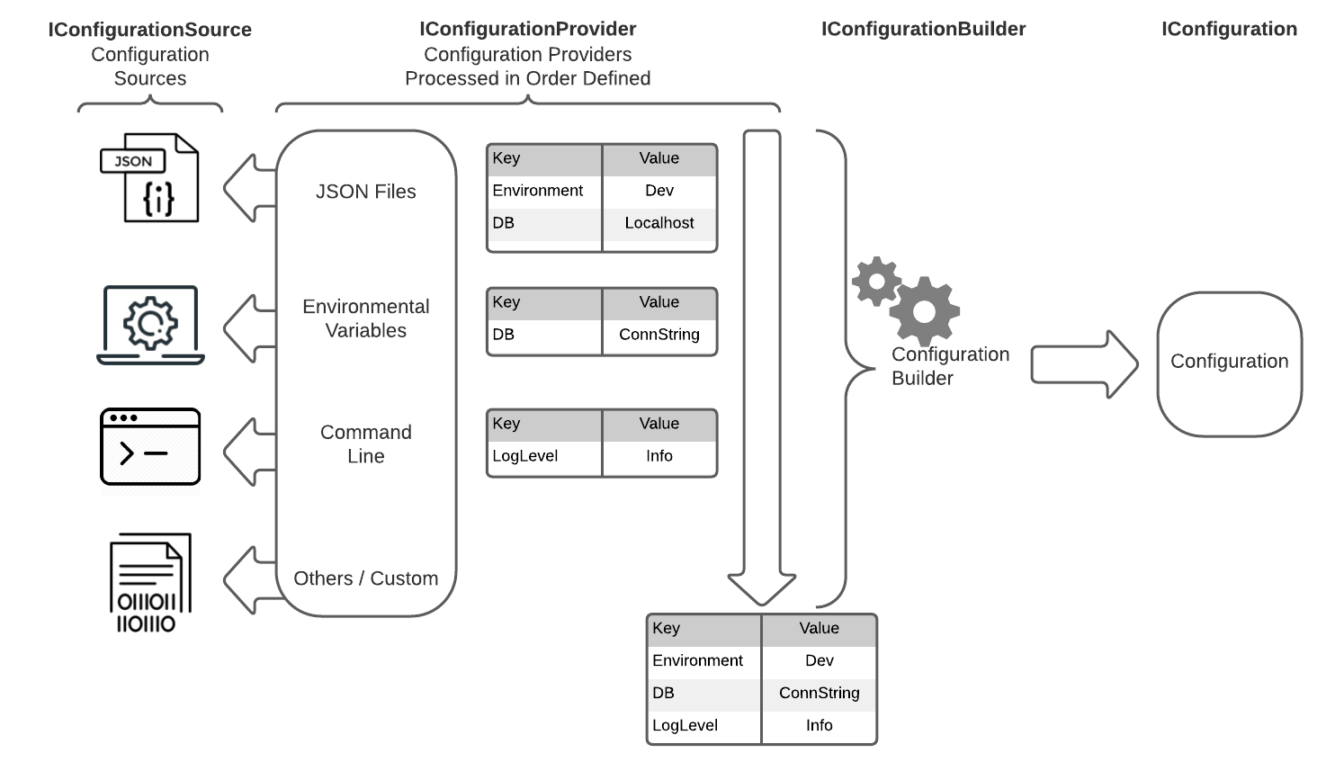
Order Matters

Slide 14
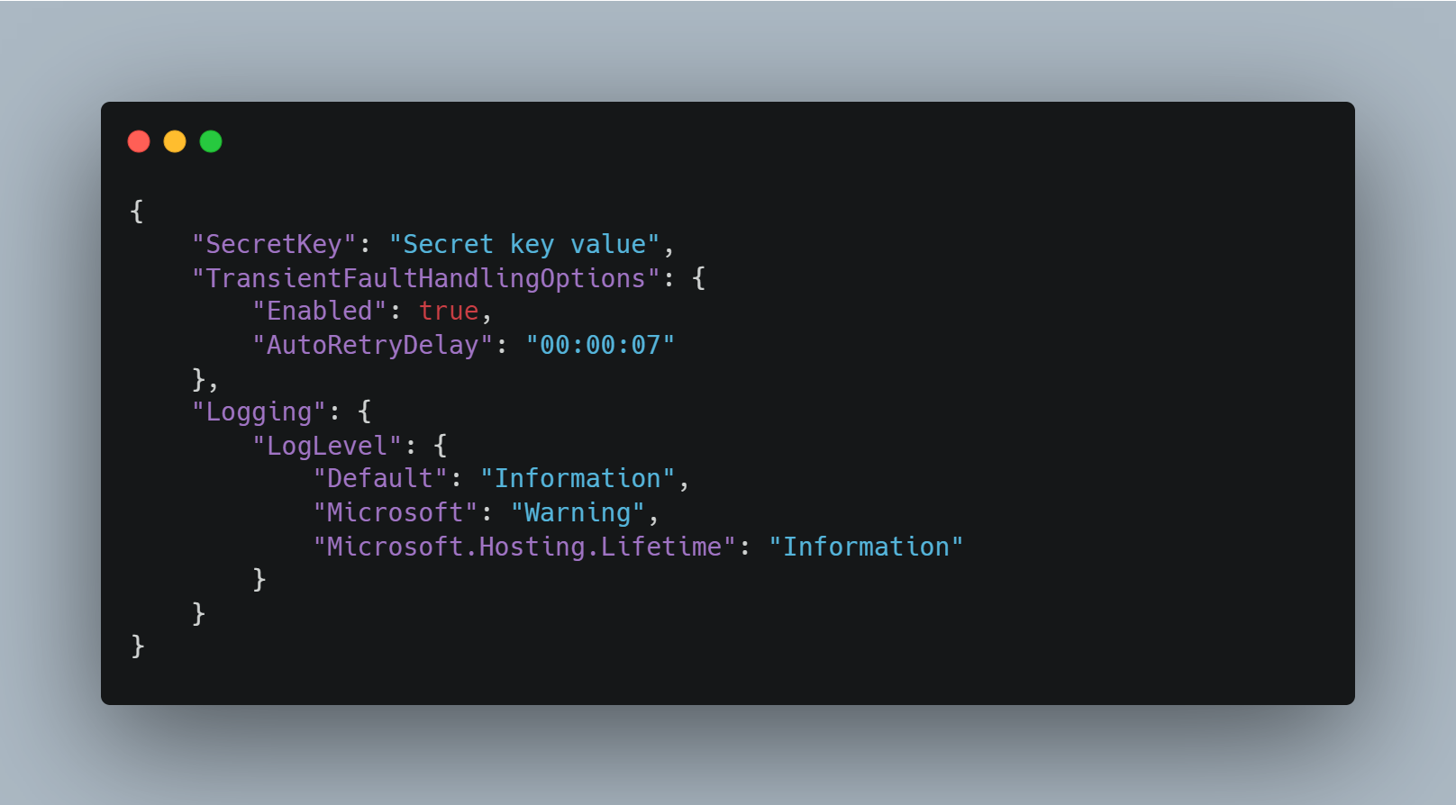
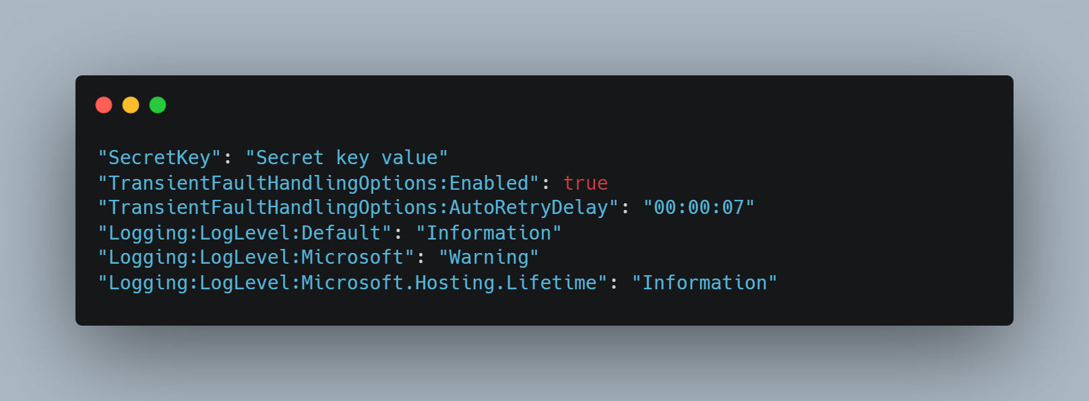
Keys are flattened

Slide 15
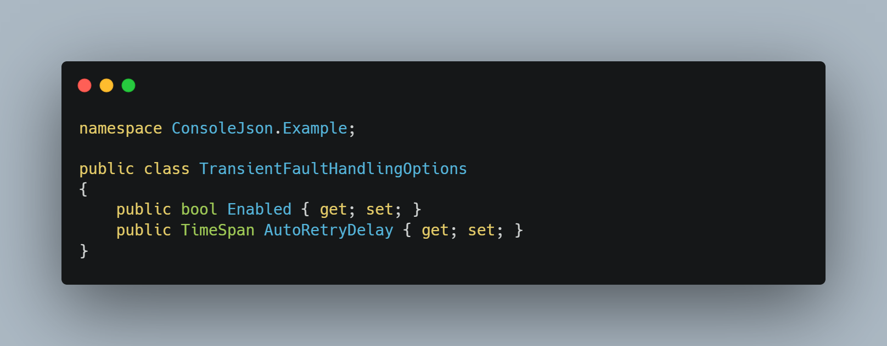
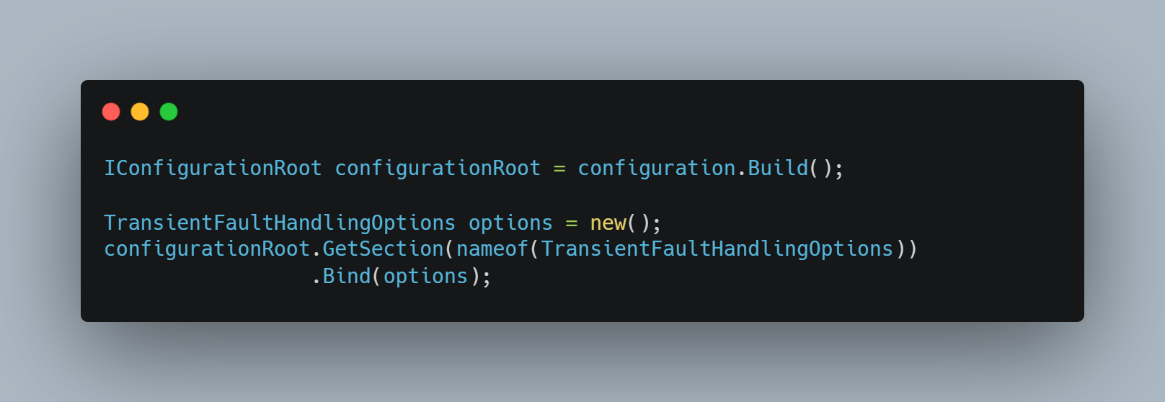
Binding a Section

Slide 16
Out of the Box
Console
No configuration
ASP.NET
CreateDefaultBuilder
JsonFileProvider = 'appsettings.json’
JsonFileProvider = 'appsettings.[EnvironmentName].json’
UserSecretsProvider
CommandLineProvider
EnvironmentVariablesProvider

Slide 17
Configuration Providers
File configuration provider
JSON configuration provider
XML configuration provider
INI configuration provider
Environment variable configuration provider
Command-line configuration provider
Key-per-file configuration provider
Memory configuration provider

Slide 18
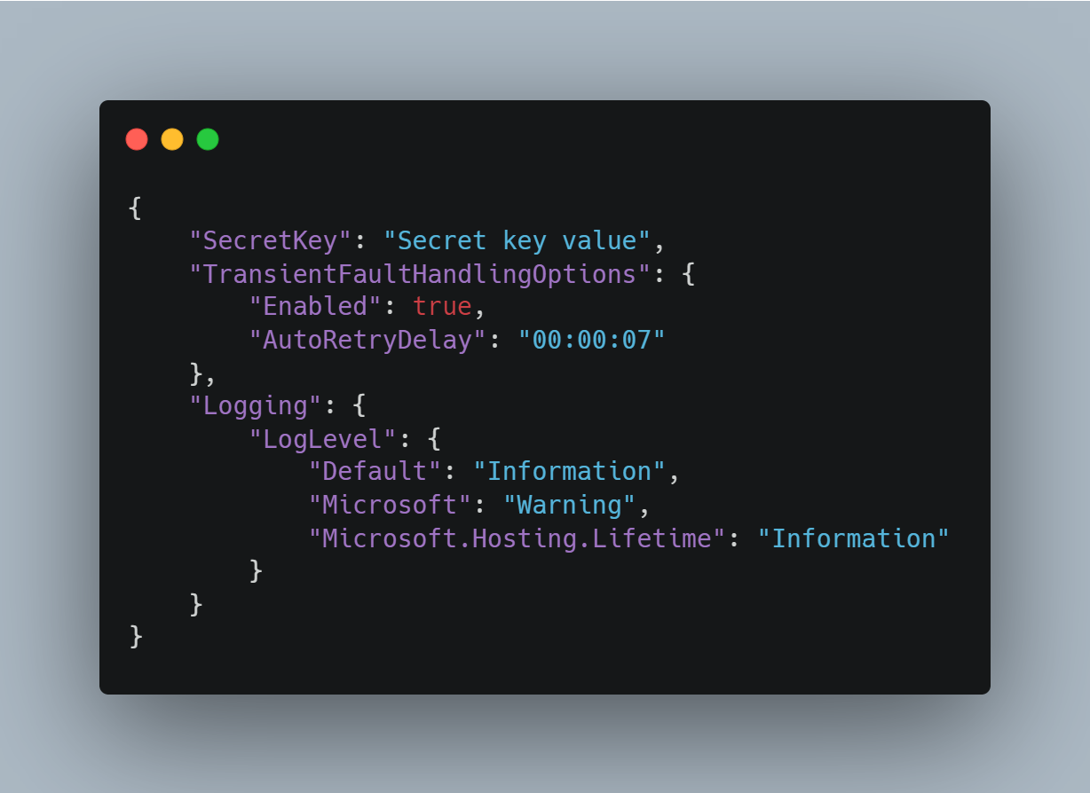
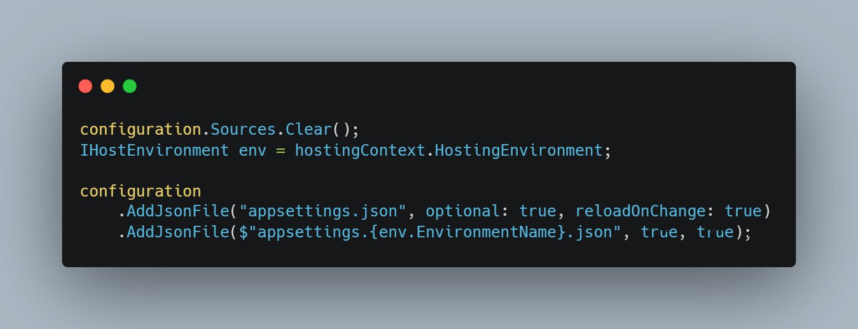
Json Provider

Slide 19
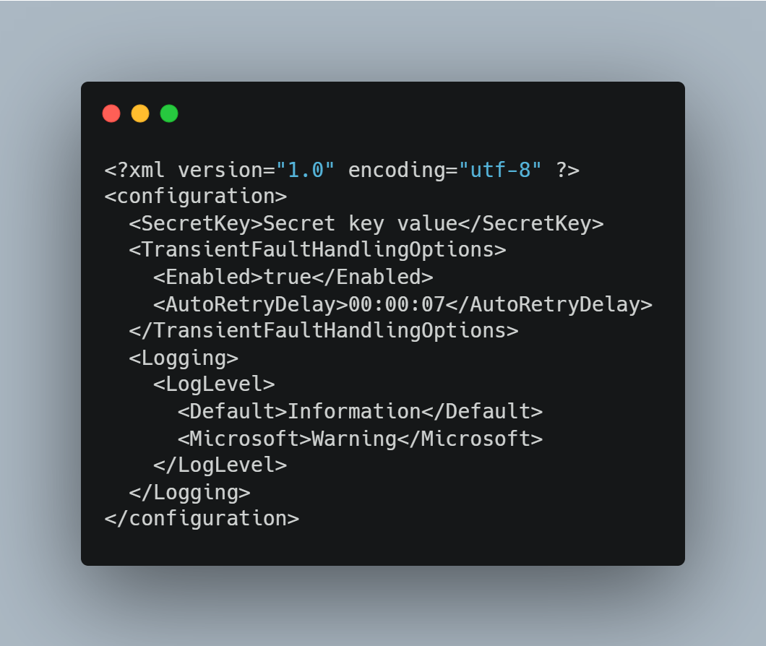
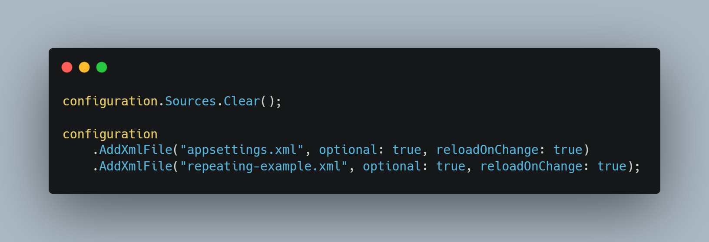
Xml Provider

Slide 20
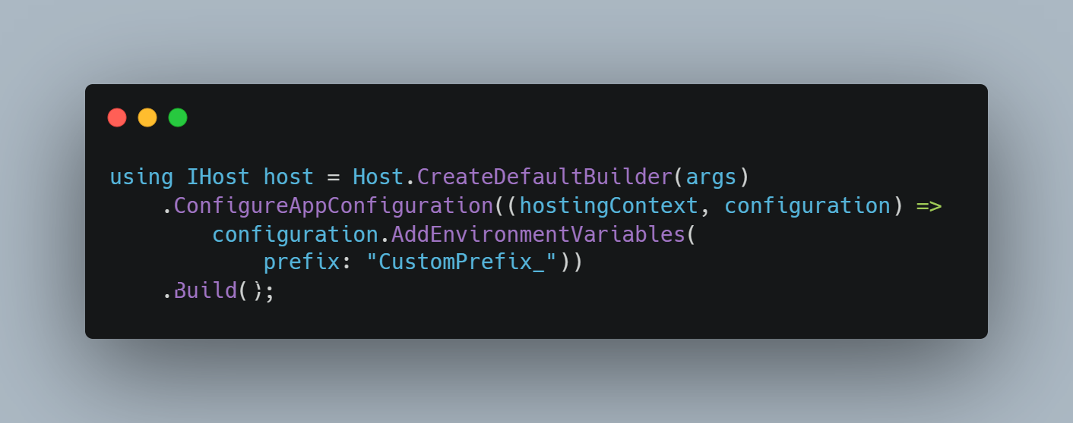
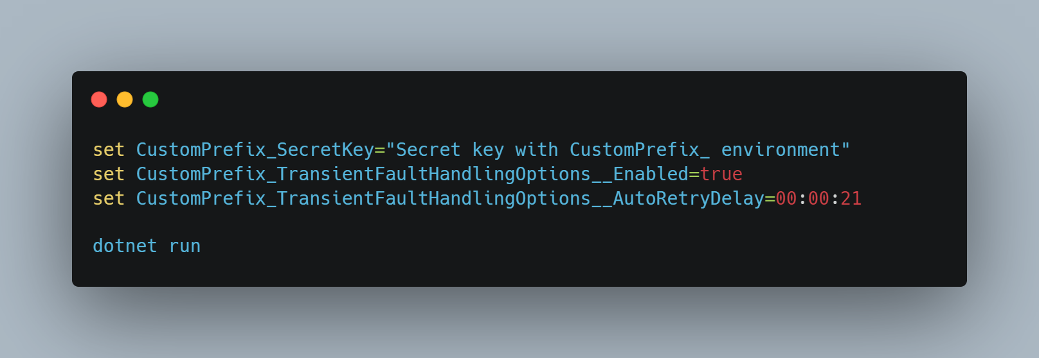
Environment Variables

Slide 21
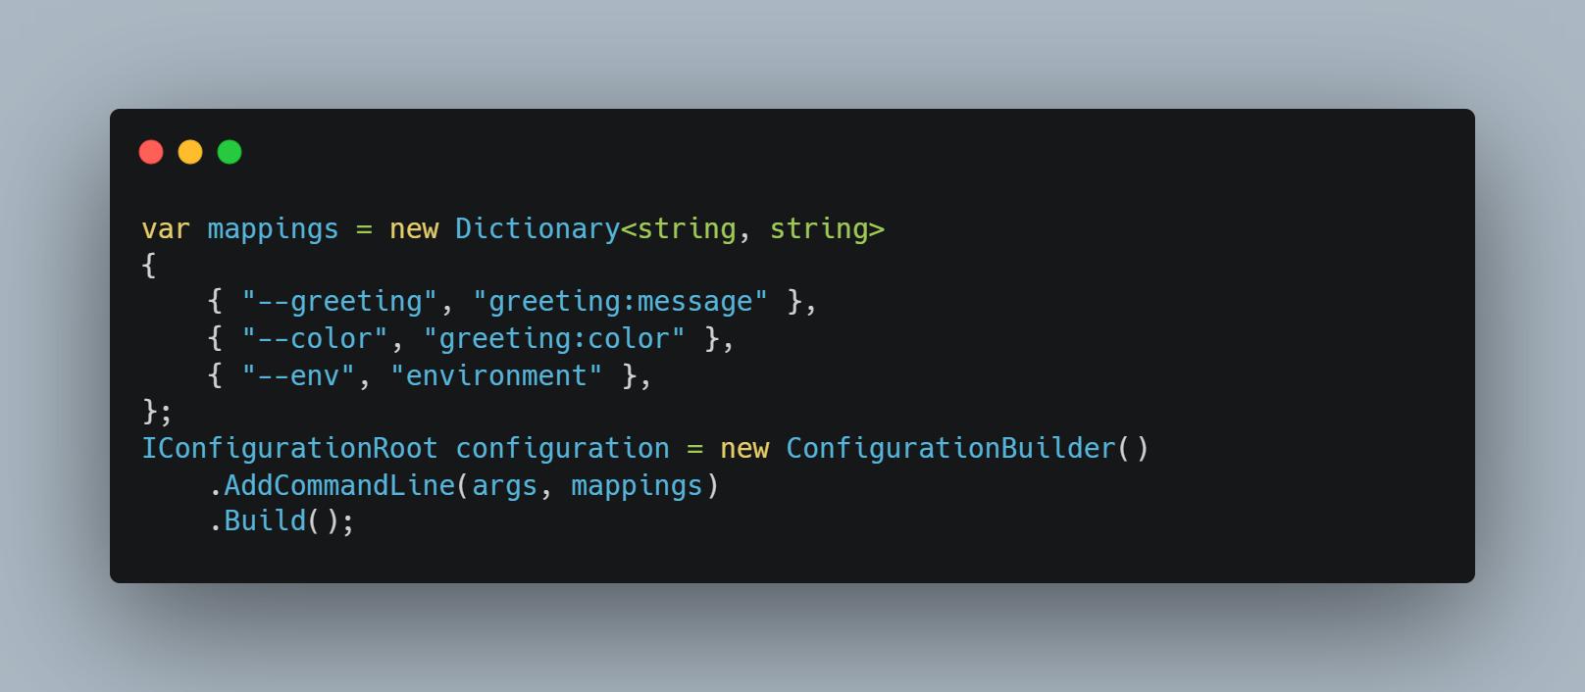
Command Line Variables

Slide 22
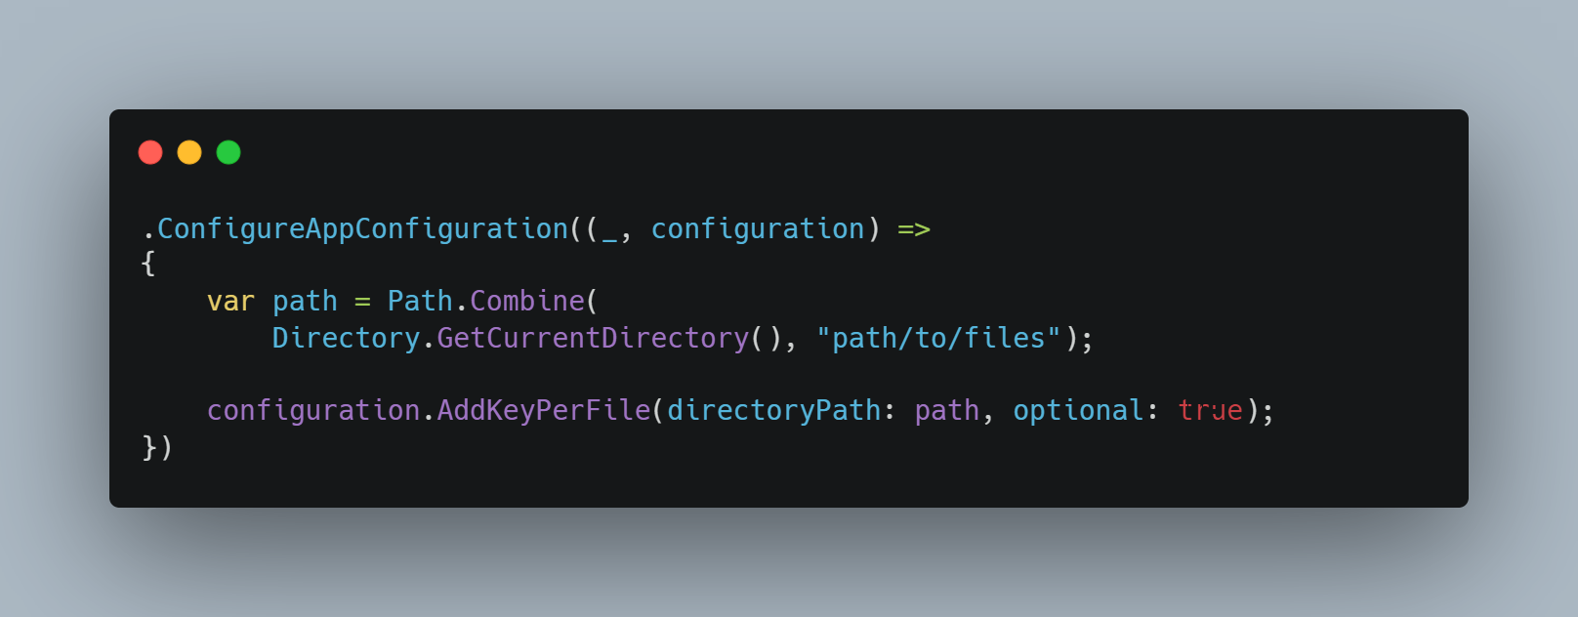
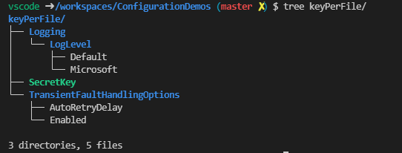
Key-per-file

Slide 23
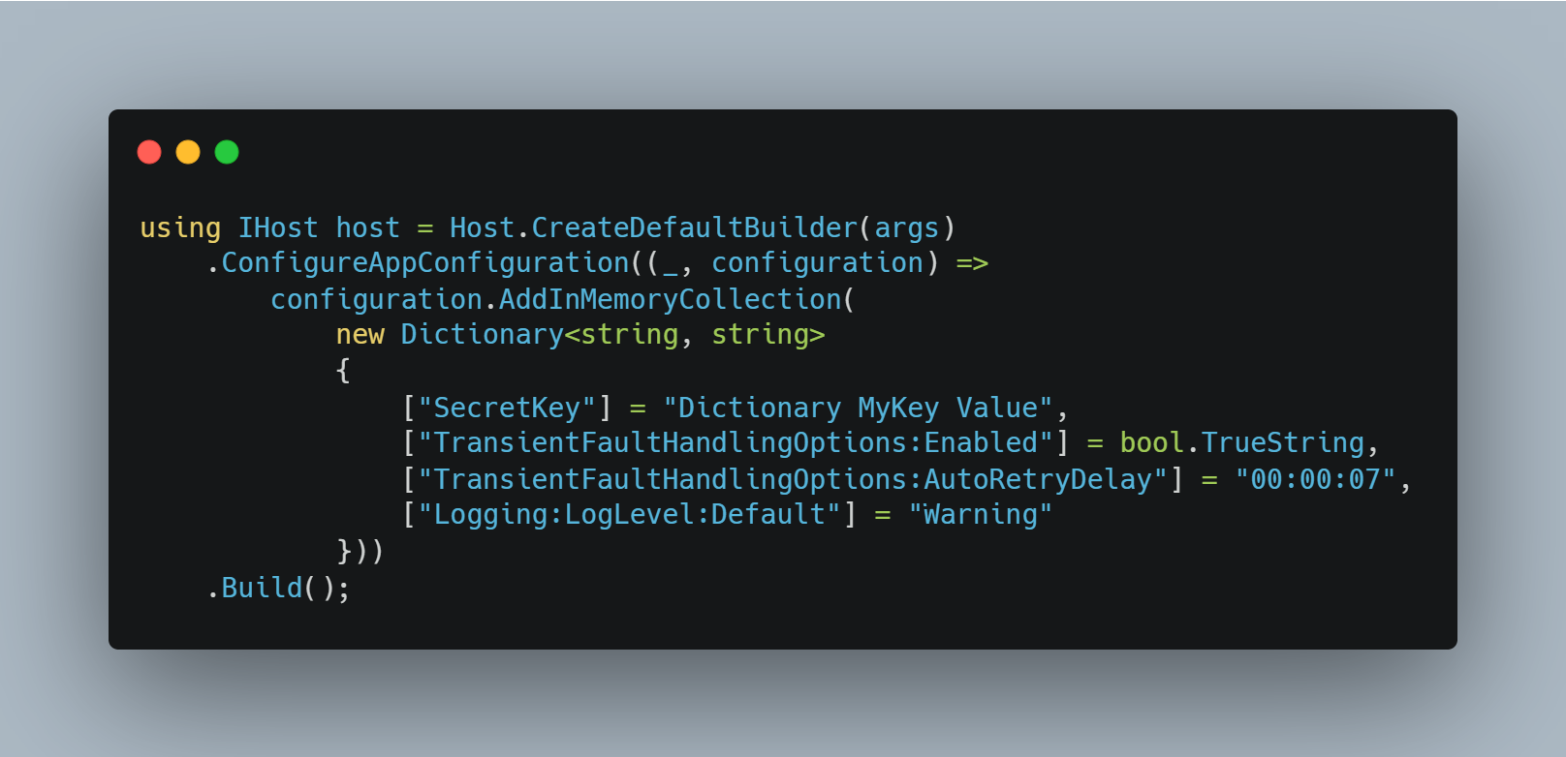
In Memory

Slide 24
Options Pattern

Slide 25
The Options Pattern
The Interface Segregation Principle (ISP) or Encapsulation: Scenarios (classes) that depend on configuration settings depend only on the configuration settings that they use.
Separation of Concerns: Settings for different parts of the app aren't dependent or coupled to one another.

Slide 26
Types of IOptions
 | Singletons | Reloading | Named
IOptions<T> | Yes | No | No
IOptionsSnapshot<T> | No | Yes | Yes
IOptionsMonitor<T> | Yes | Yes | Yes

Slide 27
DEMOS

Slide 28

Questions?
Twitter: @Chris_L_Ayers LinkedIn: Chris-L-ayers Blog: https://chrislayers.com/ GitHub: @Codebytes

Slide 29

Feedback!

